Slide 1
Engineering Materials –Structure and Properties
10 Marks
Visit for more Learning Resources

Slide 2
Co related to chapter
Identify crystal structure and properties of material.

Slide 3
Types of Engineering Materials
Broadly Engineering Materials are classified as:
Engineering Materials
Polymers
Composites
Metals &Alloys
Ceramics
ThermoplasticPolymers
ThermosettingPolymer
Elastomers

Slide 4
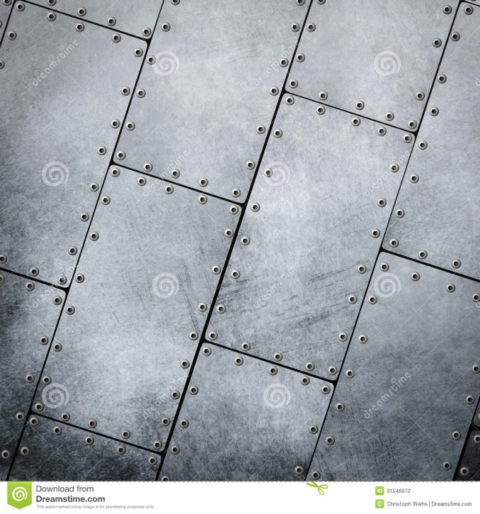
METAL
A solid material which is typically hard, shiny, malleable, fusible, and ductile, with good electrical and thermal conductivity
(e.g. iron, gold, silver, and aluminum, and alloys such as steel)

Slide 5
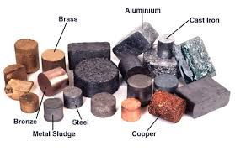
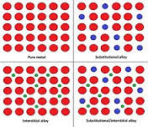
ALLOY
An alloy is a material composed of two or more metals or a metal and a nonmetal.

Slide 6
Types of Engineering Materials
Metals & Alloys are futher classified as:
Metals & Alloys
Ferrous
Non-ferrous
Cu-Alloys
Al-Alloys
Steels
Cast Irons
Ni-Alloys
Plain Carbon Steels
White Cast Iron
Alloy Steels
Malleable Cast Iron
Grey Cast Iron
S.G. Cast Iron
Chilled Cast Iron

Slide 7
Ferrous: iron as main constitute
Non ferrous: other than iron as main constitute.
Steel: carbon less than 2 %.
Cast iron: carbon more than 2%.
Cu alloy: cu as main content.
Al alloy: Al as main content.
Ni alloy: Ni as main content.

Slide 8
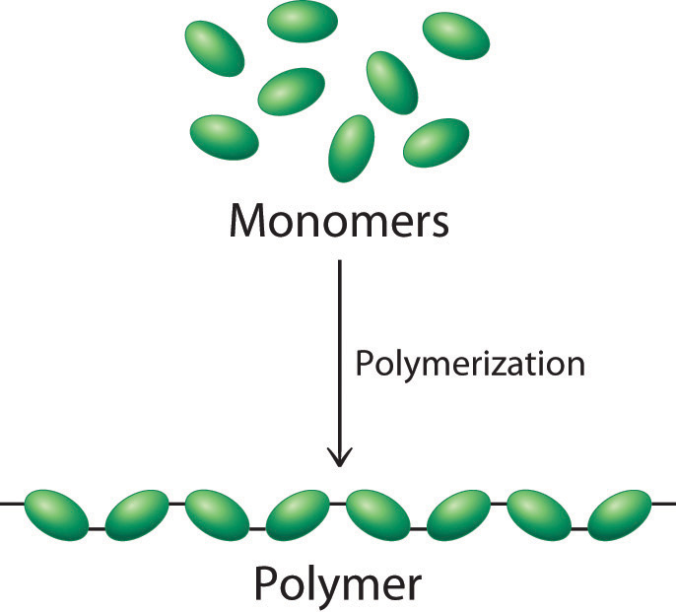
POLYMER
The word polymer means
Poly means many and meros means units, parts.
Polymer means many parts or many units

Slide 9


THERMOPLASTIC POLYMER
A thermoplastic, or thermosoftening plastic, is a plastic material, polymer, that becomes pliable or moldable above a specific temp and solidifies upon cooling.
thermoplastics may be reshaped by heating Temperature and solidifies upon cooling.

Slide 10
Thermosetting polymers
Thermosetting polymers have their chains cross linked by covalent bonds.
The starting materials are placed into a mould to form the desired shape.
The polymer is then heated (or initiated with uv light) and chemical reactions occur to form the cross links between the chains.
The resulting three dimensional solid structure cannot then be changed.
Further heating will not cause the polymer to soften, melt or change shape (unlike thermosoftening polymers).

Slide 11
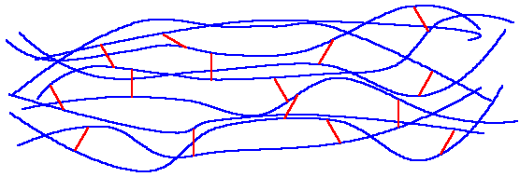
Thermosetting polymers
The picture below shows a typical structure for a thermosetting polymer. The red lines represent the cross links between the chains.

Slide 12
Examples
Epoxy resins - used as coating materials, caulks, manufacture of insulating materials, etc ...
Phenolic resins - tool handles, billiard balls, sprockets, insulation, etc ...
Unsaturated polyester resins - manufacture of plastics reinforced fiberglass commonly known as polyester, fillers, etc ...

Slide 13

Elastomers
Elastomer materials are those materials that are made of polymers that are joined by chemical bonds, acquiring a final slightly crosslinked structure.

Slide 14
Natural rubber - material used in the manufacture of gaskets, shoe heels...
Polyurethanes - Polyurethanes are used in the textile industry for the manufacture of elastic clothing such as lycra, also used as foam, wheels, etc ...
Polybutadiene - elastomer material used on the wheels or tires of vehicles, given the extraordinary wear resistance.
Neoprene - Material used primarily in the manufacture of wetsuits is also used as wire insulation, industrial belts, etc ...
Silicone - Material used in a wide range of materials and areas due their excellent thermal and chemical resistance, silicones are used in the manufacture of pacifiers, medical prostheses, lubricants, mold, etc ...

Slide 15

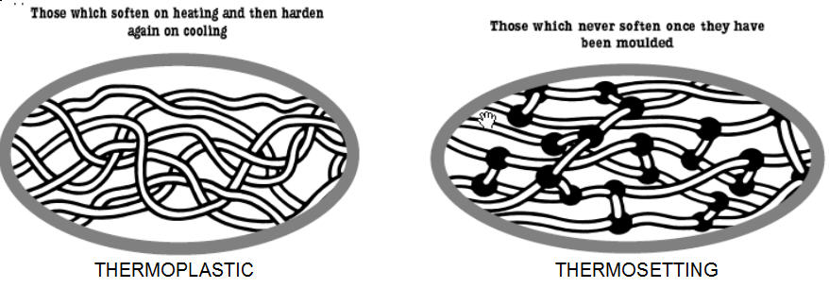

Slide 16
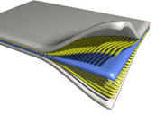
Composite
Composite materials (also called composition materials or shortened to composites) are materials made from two or more constituent materials with significantly different physical or chemical properties, that when combined, produce a material with characteristics different from the individual components.

Slide 17
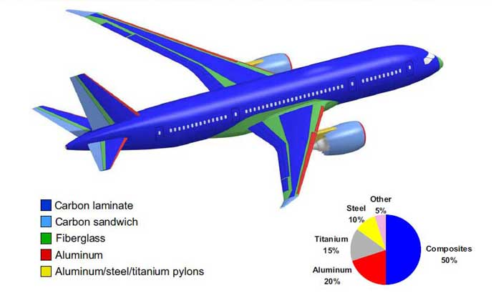
Material used in the Boeing 787

Slide 18
Types of Engineering Materials
Composites are futher classified as:
Composites
Laminar
Particle
Reinforced
Fibre Reinforced

Slide 19
Types of Engineering Materials
Ceramics are futher classified as:
Ceramics
Metal Oxides
Nitrides
Carbides
Alumina
Beryllia
Zirconia
Glass
Glass Ceramics
Ceramic s defined as any inorganic (inorganic substances do not contain carbon or its compounds)non metallic material.

Slide 20

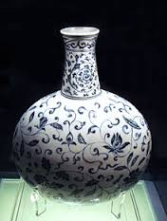


Slide 21
Amorphous material
The material have no regular arrangement of their molecules.
Material like glass and paraffin are example of amorphous material.
These material have properties of solids.
They have definite volume and shape and diffuse slowly.

Slide 22
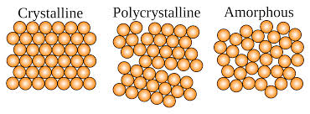
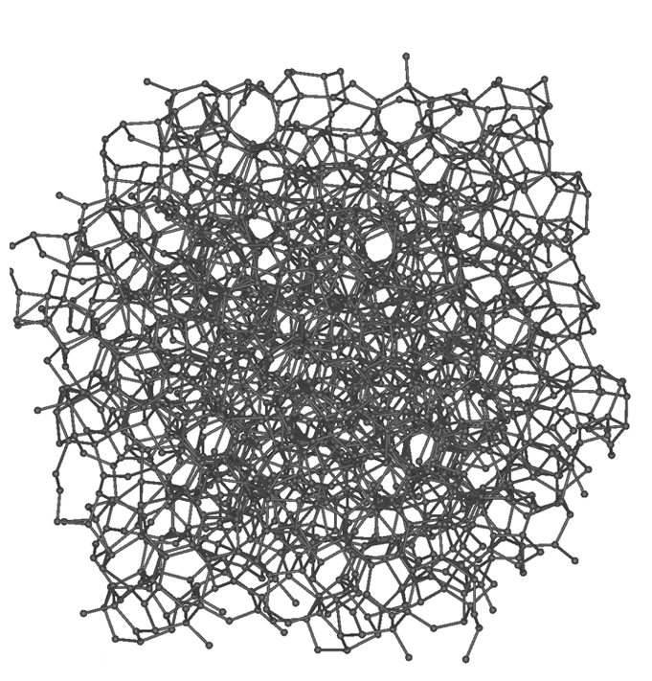
Amorphous carbon

Slide 23
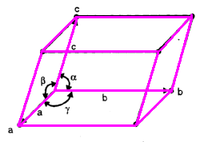
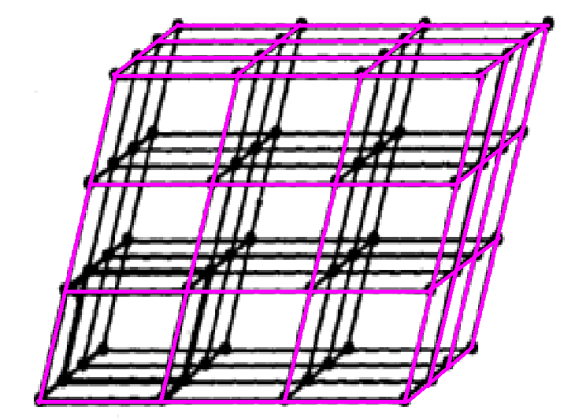
Crystalline material
In a crystalline structure , the atoms are arranged in three dimensional array called a lattice.
The lattice has a regular repeating configuration in all direction.

Slide 24
polymorphism
A crystal is defined as an orderly array of atoms in space.
Normally metals are made up of number of crystals and each crystal consist of large number of atoms.
Crystal structure is atomic arrangement in solids.
Polymorphism is the ability of solid material to exist in more than one form or crystal structure.

Slide 26
Single atom
Unit Cell
lattice

Slide 27
Crystal Structure in Metals
Majority of Metals falls in either of the following crystal structure
BCC (Body Centered Cubic)
FCC (Face Centered Cubic)
HCP (Hexagonal Close Packed)

Slide 28
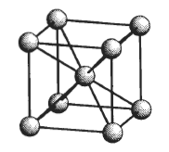
Crystal Structure in Metals
BCC (Body Centered Cubic)
Examples:α-iron, Mo, W, V, Ta, Cr, Na, K

Slide 29
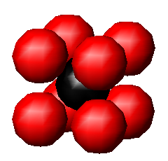
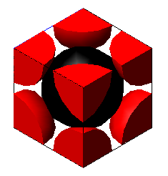
Crystal Structure in Metals
BCC (Body Centered Cubic)

Slide 30
BCC (Body Centered Cubic)
In these structure, there are 8 corner atoms and one atom at in the interior i.e. in the centre of the unit cell with no atom on face.
Therefore,
Nav = average no. of atoms per unit cell.
Nc= total no. of corner atom in unit cell.
Nf= total no. of face atom in unit cell.
Ni = center or interior atom
Nc = 8, Nf=0, Ni=1
Nav= (Nc/8)+(Nf/2)+(Ni/1)
=(8/8)+(0/2)+(1/1)
=2

Slide 31
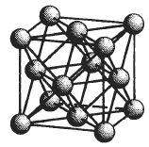
Crystal Structure in Metals
FCC (Face Centered Cubic)
Examples:γ-iron, Cu,Au,Ag,Al,Pb, Ni, Pt

Slide 32
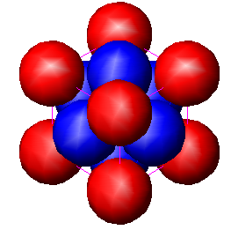
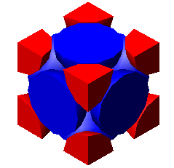
Crystal Structure in Metals
FCC (Face Centered Cubic)

Slide 33
FCC (Face Centered Cubic)
In these structure, there are 8 corner atoms and 6 atoms at centre of the face and interior atom
Therefore,
Nav = average no. of atoms per unit cell.
Nc= total no. of corner atom in unit cell.
Nf= total no. of face atom in unit cell.
Ni = center or interior atom
Nc = 8, Nf=6, Ni=0
Nav= (Nc/8)+(Nf/2)+(Ni/1)
=(8/8)+(6/2)+(0/1)
=4

Slide 34
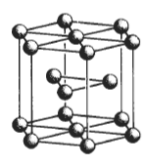
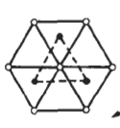
Crystal Structure in Metals
HCP (Hexagonal Close Packed)
Examples: Mg,Zn,Be,Cd,Co,Zr,Ti

Slide 35
HCP (Hexagonal Close Packed)
For hexagonal structure, the corner atoms are shared by 6 cells (3 from below and 3 from above), face atoms are shared by adjacent 2 cells, and atoms in the interior are shared by only one cell.
Nav= (Nc/6)+(Nf/2)+(Ni/1)
For HCP structure , there are 12 corner atoms, 2 atoms at the centers of the above two faces and 3 atoms in the interior of the unit cell.

Slide 36
HCP (Hexagonal Close Packed)
Nc = 12, Nf=2, Ni=3
Nav= (Nc/8)+(Nf/2)+(Ni/1)
=(12/6)+(2/2)+(3/1)
=6

Slide 37

Physical properties
Density
Density of a substance is its mass per unit volume.
The symbol most often used for density is ρ (the lower case Greek letter rho).
Mathematically, density is defined as mass divided by volume.
where ρ is the density, m is the mass, and V is the volume.

Slide 38
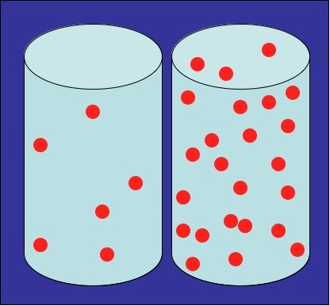
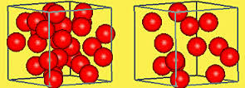
Density

Slide 39
Melting point
The melting point of a solid is the temperature at which it changes state from solid to liquid at atmospheric pressure.
The melting point of a substance depends (usually slightly) on pressure and is usually specified at standard pressure.
The melting point of ice at 1 atmosphere of pressure is very close to 0 °C (32 °F, 273.15 K).

Slide 40
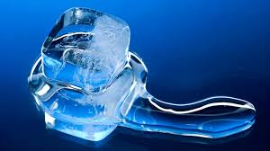
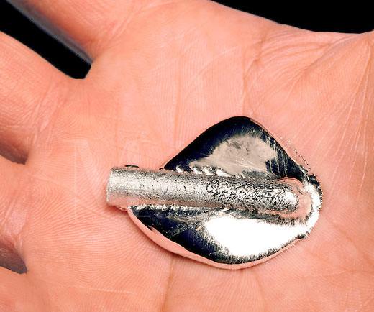

Slide 41
Specific heat
Energy required to change the temperature of an object by 1degree c.
The SI unit of heat capacity is joule per kelvin.
Metals have lower specific heat capacity than plastics.
Therefore they require less heat to reach a particular temperature than plastics.

Slide 42
Thermal expansion
Thermal expansion is the tendency of matter to change in volume in response to a change in temperature, through heat transfer.
The degree of expansion divided by the change in temperature is called the material's coefficient of thermal expansion and generally varies with temperature.
(lf-l0) / l0 = 1 (Tf-To)
Where, lf and lo are initial and final length.
Tf and T0 are initial and final temperature.
1 is coefficient of thermal expansion.
Unit is reciprocal temperature i.e. 1/c°

Slide 43
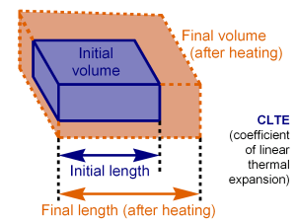

Slide 44
Thermal conductivity
It is the property of a material to conduct heat.
often denoted k, λ, or κ.
In SI units, thermal conductivity is measured in watts per meter kelvin (W/(m·K))
High energy generation rates within electronics or turbines require the use of materials with high thermal conductivity such as copper (see: Copper in heat exchangers), aluminium, and silver.
On the other hand, materials with low thermal conductance, such as polystyrene and alumina, are use in building construction or in furnaces in an effort to slow the flow of heat, i.e. for insulation purposes

Slide 45
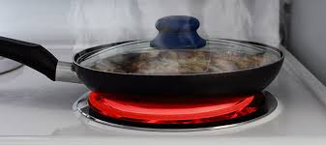

Slide 46
Mechanical properties
Strain
Change in dimension per unit original dimension is nothing but strain.
Stress
Applied force per unit area is nothing but stress.
σ= F/A.
N/mm2.

Slide 47
Strength
Ability of a material to resist the externally applied force without breaking or yielding.
Stiffness
It is ability of material to resist deformation under stress.
Elasticity
It is property of material to regain its original shape after deformation when the external force are removed.
Steel is more elastic than rubber.
Plasticity
It is property of a material which retains the deformation produced under load permanently.

Slide 48
Ductility
It is ability of a material enabling it to be drawn in to wire with the application of a tensile force.
Steel copper aluminium nickel zinc lead tin
Brittleness
It is property of a material opposite to ductility.
It is the property of breaking of material with little permanent distortion.
Cast iron is a brittle material
Malleability
It is special case of ductility which permits materials to be rolled or hammered in to thin sheets.
Lead soft steel wrought iron copper aluminium.

Slide 49
Toughness
It is property of material to resist fracture due to high impact load like hammer blow.
Machinability
It is property of a material which refers to relative case with which a material can cut.
Resilience
It is property of a material to absorb energy and resist shock and impact load.
Creep
When a part is subjected to a constant stress at high temperature for long period of time, it will under go slow and permanent deformation called creep.

Slide 50
Fatigue
When a material is subjected to a repeated stresses, it fails at a stresses below the yield point stresses. Such type of failure of material is called fatigue.
Hardness
Resistance to wear, scratching, deformation and machinability.
It also mean ability of material to cut another metal.

Slide 51
Packing efficiency
The packing efficiency is the fraction of crystal occupied by the atoms.
It must be always less than 100%. Because it is impossible to pack spheres without empty space between them.
Packing efficiency is the percentage of total space filled by the particles.
It is also called as atomic packing factor.
(Volume occupied by atoms in unit cell/ total volume of unit cell ) x100

Slide 52
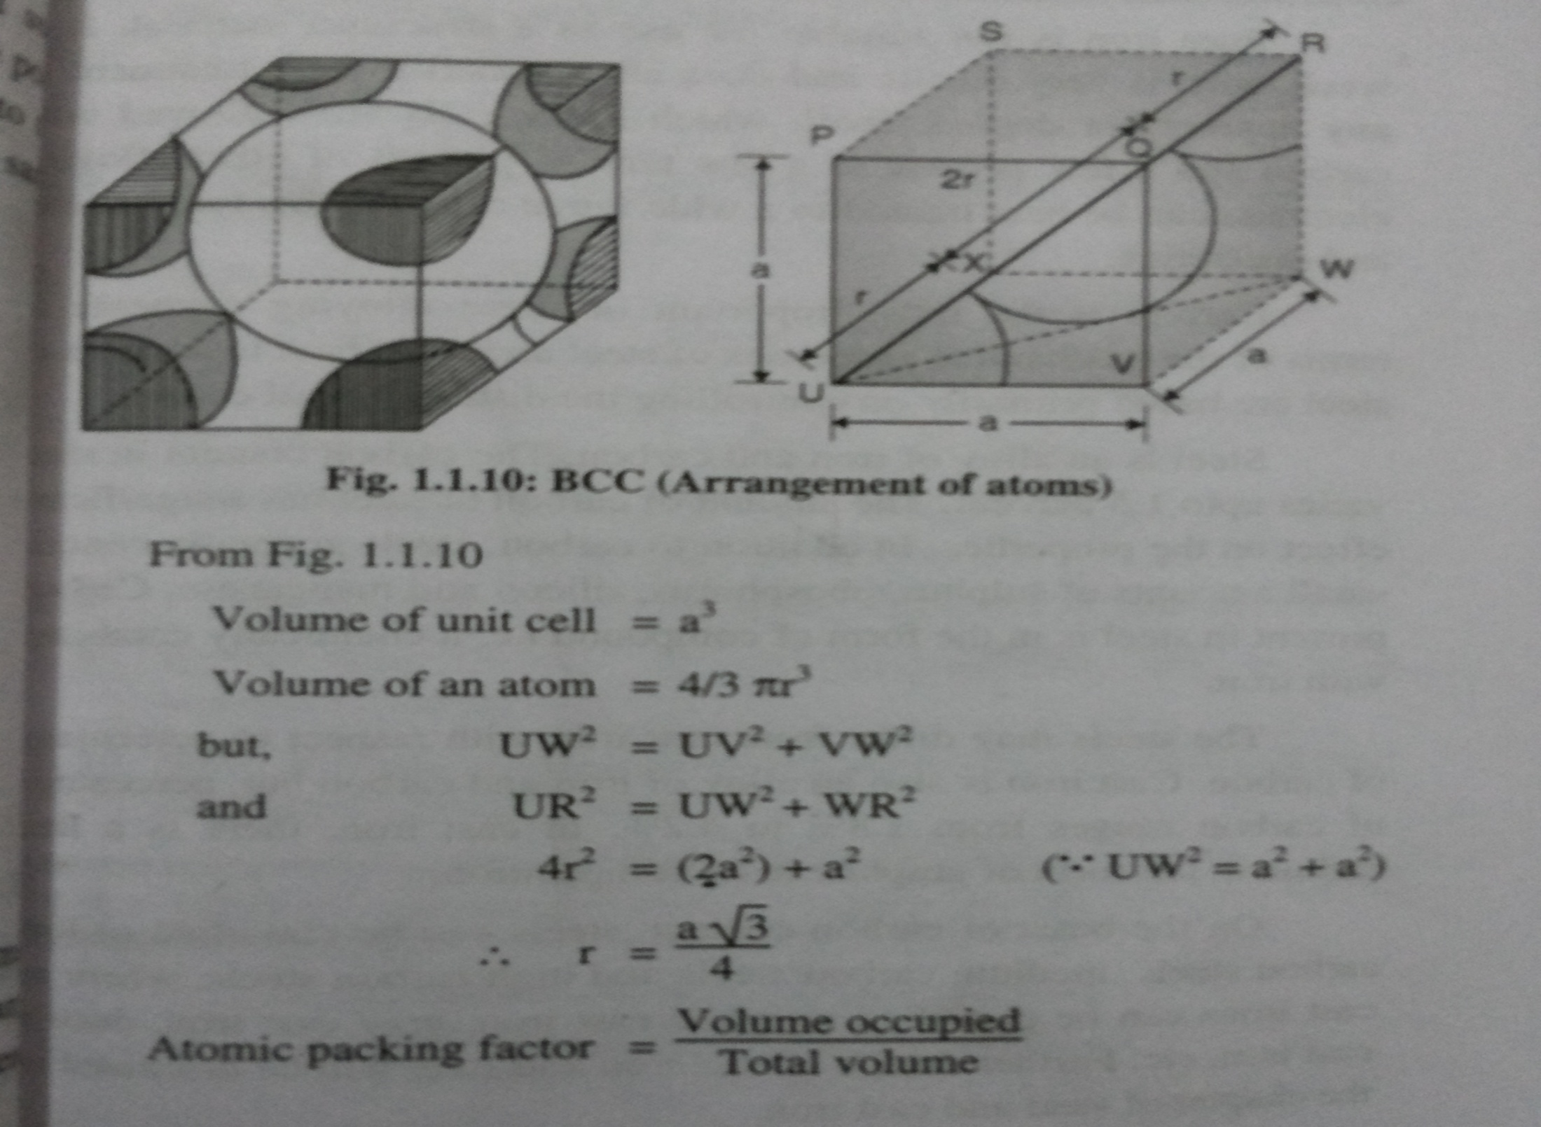
Packing efficiency for Bcc structure

Slide 53
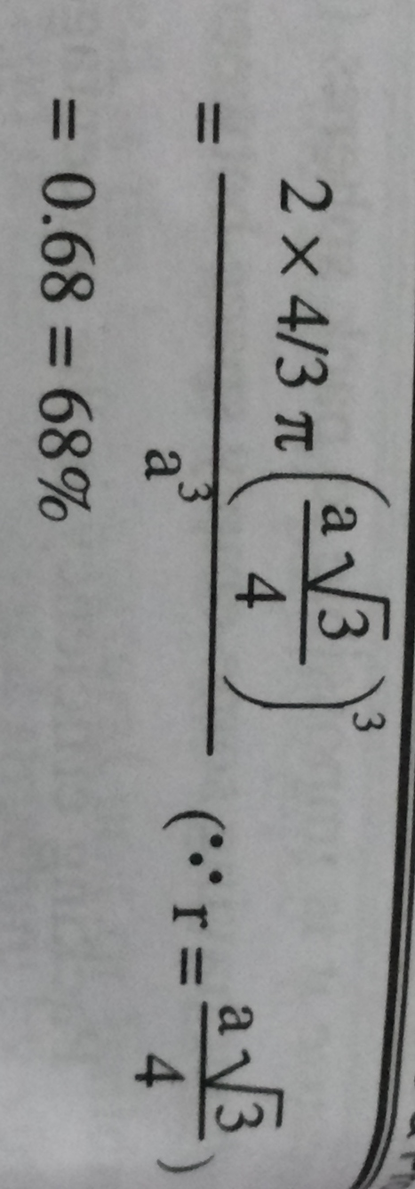
For more detail contact us

